Slide 1

Test Driven Development in Python
A Practical Introduction
Patrick Gavigan
Data Science Team, OCDO

Slide 2
Goal: Trustworthy and Maintainable software
Loosely Coupled
Highly Cohesive
Well Documented
Thoroughly Tested

Slide 3
What is Test Driven Development?
Write a Failing Test
Make the Test Pass
Refactor

Slide 4
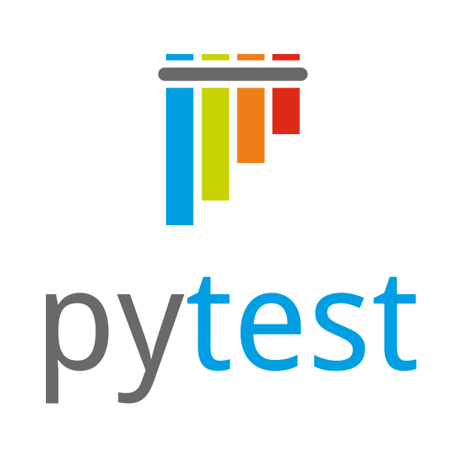
Testing Frameworks!
Inversion of control
Repeatable
Can be integrated with Source Control
Contributes to Documentation

Slide 5
Implementing Tests
Test Cases
Compare Actual to Expected output
Parameterized Tests
One test, many cases
Test Fixtures
Setup and tear down tests

Slide 6
DEMO!

Slide 7
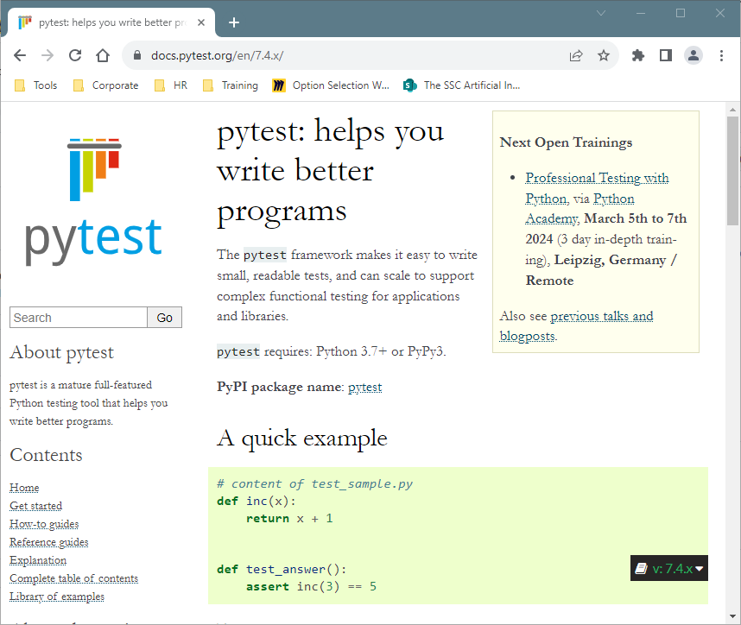
Resources
https://docs.pytest.org/

